Slide 1
Music API Project
Data Analysis to Identify Trends

Slide 2
Team Members
Andy Fernandez Godday Ogbo
Bamidele Funminiyi Samuel Luis Gonzalez

Slide 3
Summary
Our project is to explore music data in order to uncover hidden insights for our clients – concert promoters / event organizers.
Our data analysis will reveal musical preferences of the general population – genre, artists, tracks, and lyrics.
The insights we provide will help guide our clients’ decisions in organizing the events by booking the right artist, and their respective genres and performing the right songs or tracks.
AF

Slide 4
Questions & Goals
Questions:
Who are the top artists?
What are the top songs?
What are the top genres?
What words occur the most in the song title or lyrics?
What are the general trends over time?
Goal(s):
Our clients’ job / need is to maximize ticket sales and other revenues from their events. Insights from our project will help ensure their success.
AF

Slide 5

Data Source & Method
Summarize where and how you found the data you used to answer these questions
Kaggle – main data set
Last FM API – listeners, play count
https://www.last.fm/api
Word Cloud Library – lyrics
AF

Slide 6
Data Exploration & Cleanup
For our data cleanup and exploration, we each did our own searching and shared our findings with each other and gave input on how the data could help answer our questions.
Through our searching, we realized how extensive the data can get. The datasets that we used for our analysis were from numerous sources however the bulk of the data came from Last.FM from, where we had to do an API call to extract detail information on each selected artist.
Although we had originally tried to include the personal details like age, birth date and country of origin, of the top artist, our searches came up with insufficient data, as well as insufficient historical data that we could use for our analysis.
GO

Slide 7
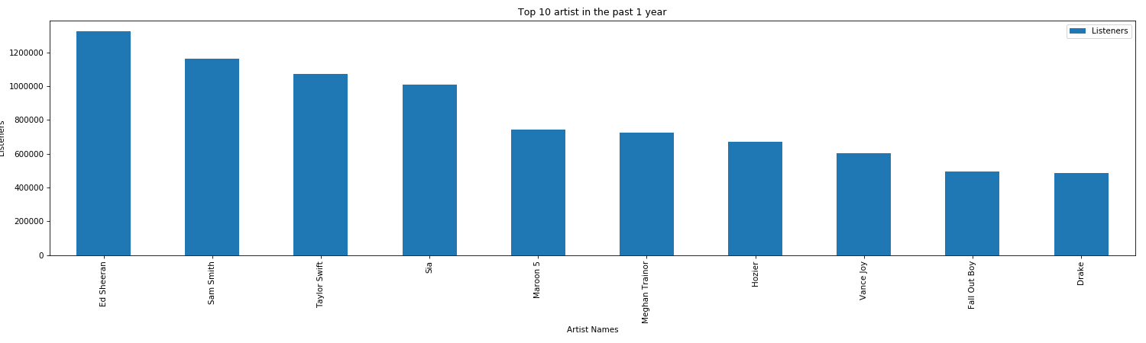
Graphs
GO

Slide 8
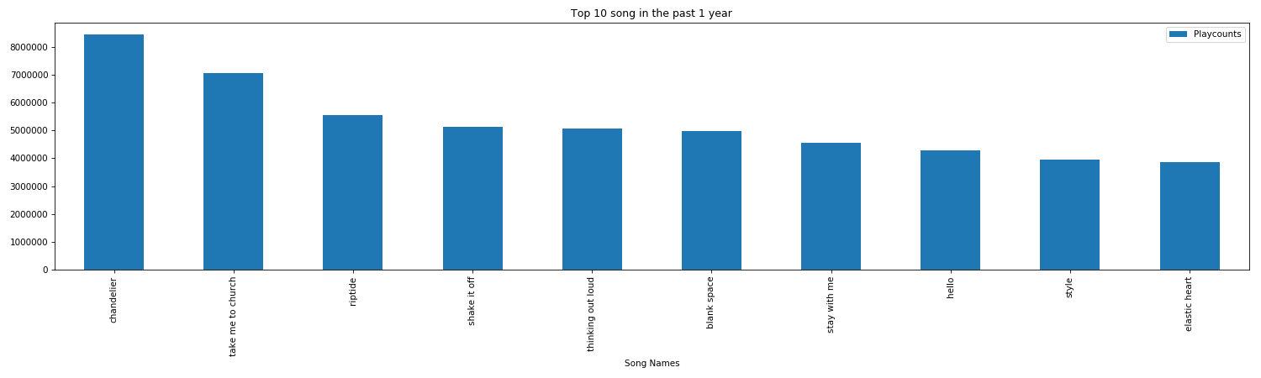
Graphs
GO

Slide 9
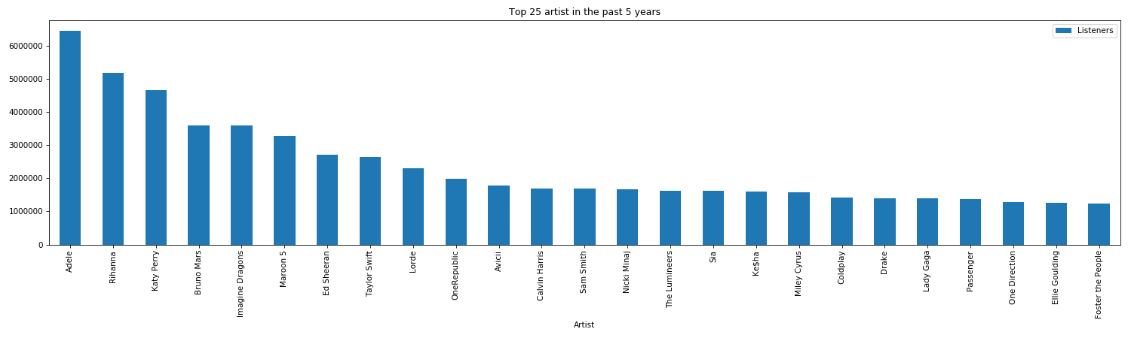
Graphs
GO

Slide 10
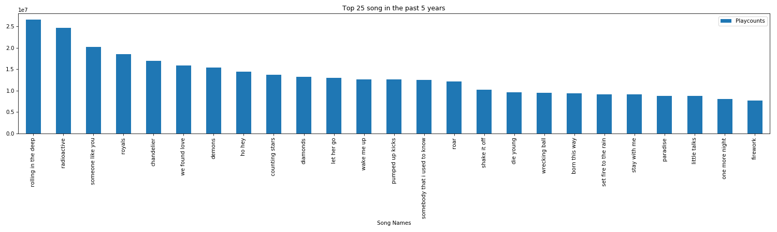
Graphs
GO

Slide 11
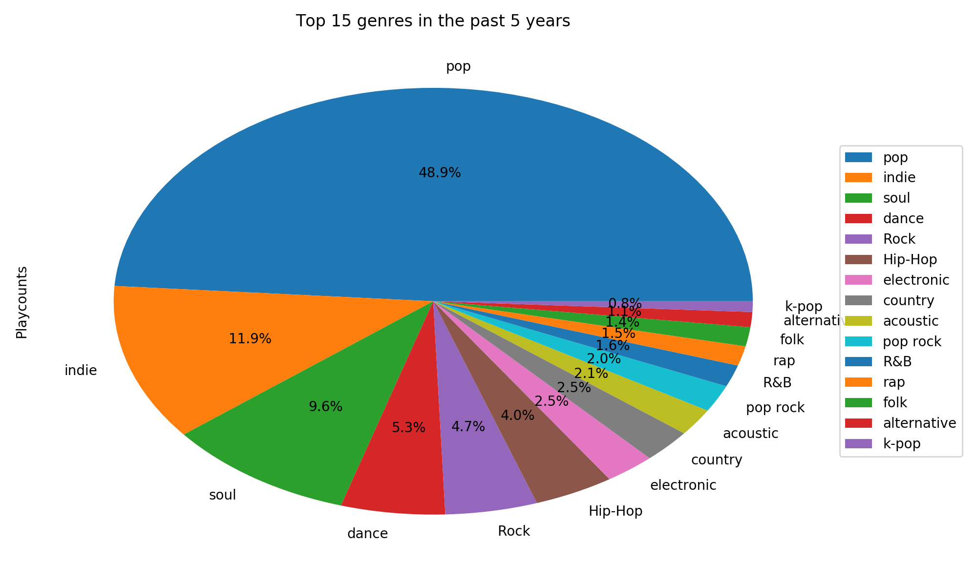
Charts
FS

Slide 12
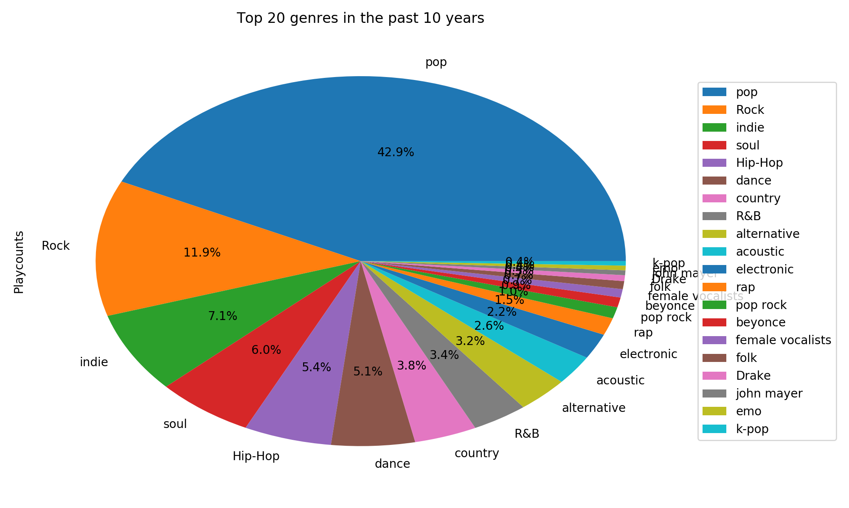
Charts
FS

Slide 13
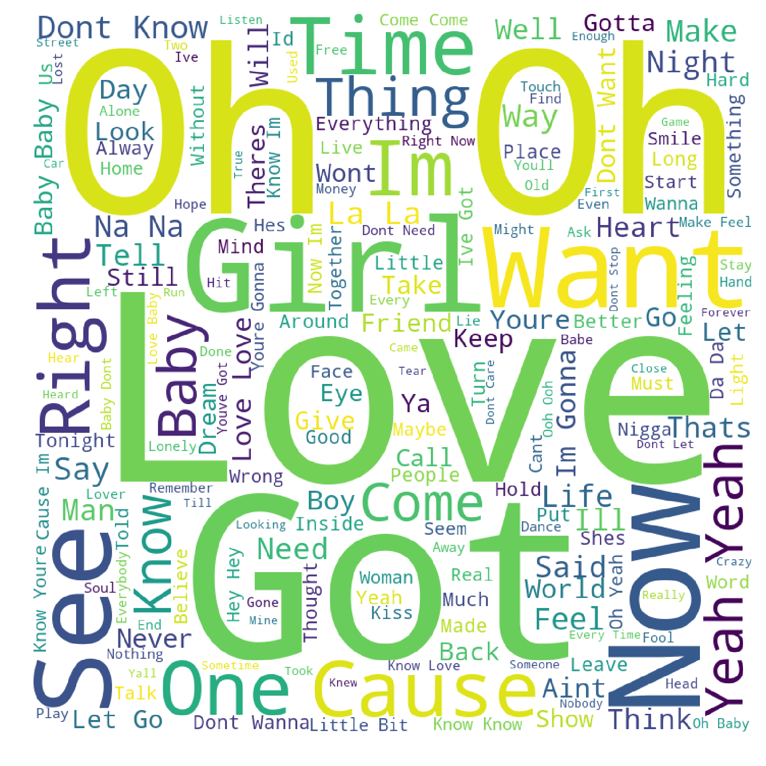
Word Cloud of Lyrics
LG

Slide 14
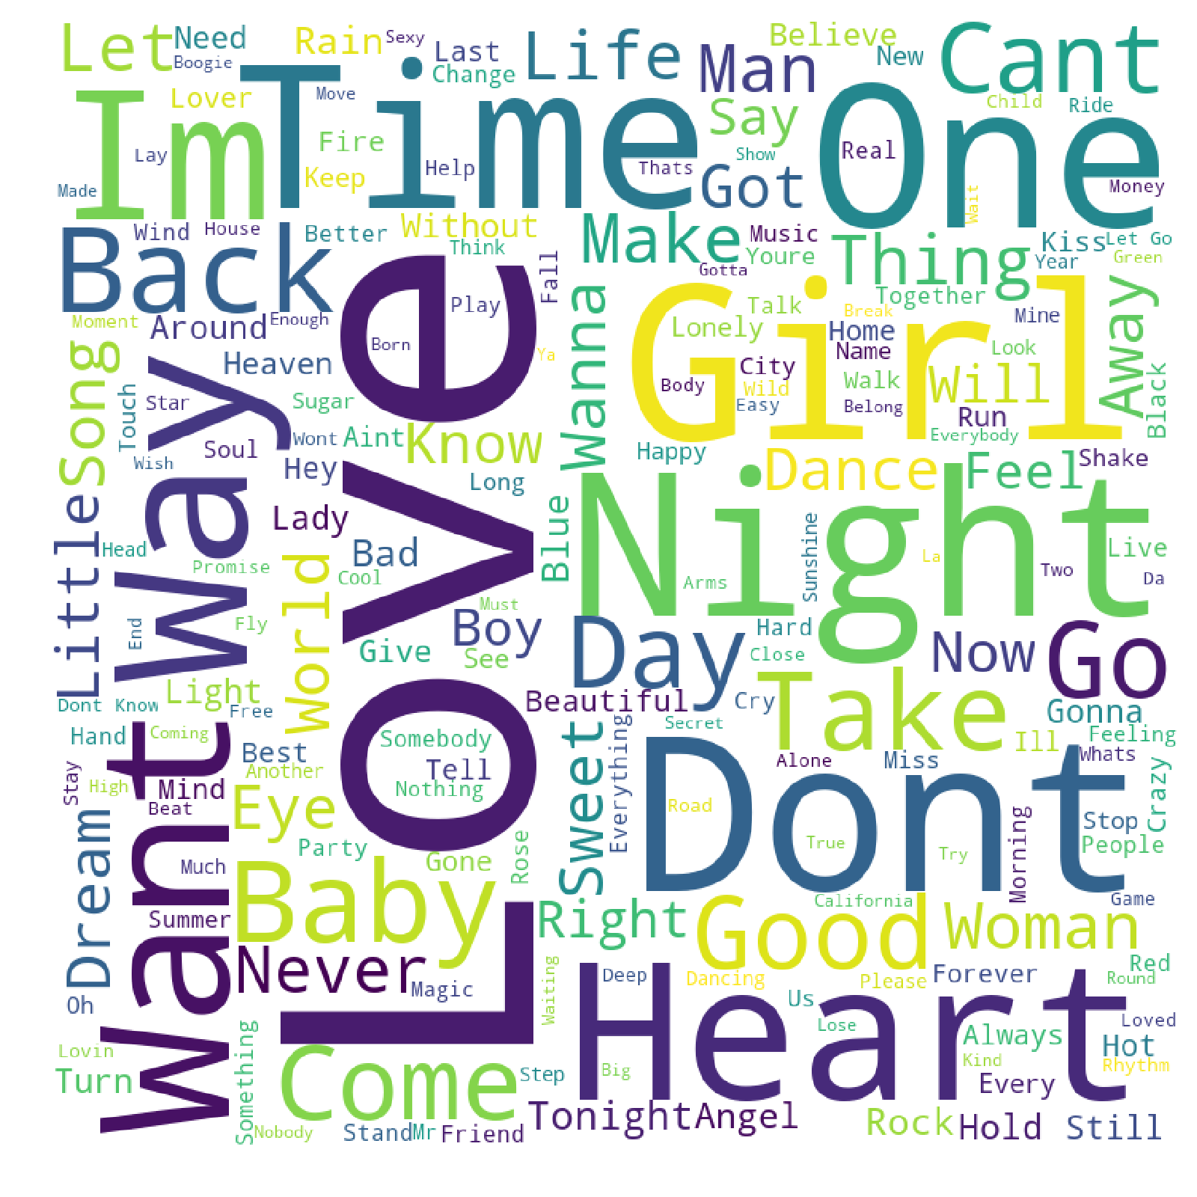
Word Cloud of Song Title
LG

Slide 15
Questions & Answers
Who are the top artists?
Rihanna, Katy Perry, Lady Gaga, Adele, Taylor Swift, Kanye West, Black Eyed Peas, Beyoncé, Britney Spears, Cold Play, Bruno Mars & Maroon 5
What are the top songs?
Rolling in the Deep (Adele), Radio Active (Imagine Dragons), Someone like You (Adele), Royals (Lorde) & Chandelier (Sia)
What are the top genres?
Pop, Rock, Indie, Soul & Hip Hop
What words occur the most in the song title or lyrics?
LOVE Want / Got GIRL, Oh-Oh!
What are the general trends over time?
Pop music dominates & songs about LOVE is what the people want
Is it possible to identify geographic locations of listeners?
Yes, but need another API data source with user data/geo-location; possibly Spotify
LG

Slide 16
Findings & Meaning
Who are the top artists?
Rihanna, Katy Perry, Lady Gaga, Adele, Taylor Swift, Kanye West, Black Eyed Peas, Beyoncé, Britney Spears, Cold Play, Bruno Mars & Maroon 5
What are the top songs?
Rolling in the Deep (Adele), Radio Active (Imagine Dragons), Someone like You (Adele), Royals (Lorde) & Chandelier (Sia)
What are the top genres (10/5 years)?
Pop (43/49%), Rock (12/5%), Indie (7/12%), Soul (6/10%) & Hip Hop (~5%)
What words occur the most in the song title or lyrics?
LOVE Want / Got GIRL, Oh-Oh!
What are the general trends over time?
Pop music dominates & songs about LOVE is what the people want
LG

Slide 17
Challenges
Unclean Data Set
User input-data
Geo-Location Data
API Limitation
LG

